Slide 1
Data Visualizations & Storytelling
Task Overview:
The overall narrative is positive. Our company has achieved $2.33 million in sales and $292.30 thousand in profit, with a clear upward trend over the past four years. The most recent year, 2024, saw a significant jump in sales, making it our most successful year on record.

Slide 2
Key Characters and Plot Points
The Growth Engine: The Technology category is the hero of our story. Its sales have exploded year-over-year, especially in 2024. Within this category, Phones are a star performer, second only to Chairs in total sales. This category is the main driver of our recent success.
The Top Performer: Geographically, the West region is our most profitable, contributing a massive 37.9% of our total profit. This region is a goldmine and should be studied for best practices.
The Heavy Hitters: While Technology drives growth, our main revenue comes from a few core product lines. Chairs and Phones are our top-selling products by a large margin, making them the foundation of our business.
The Unsung Hero: A key metric to note is our low Sum of Discount ($1.58K) relative to our sales, which indicates strong pricing power and healthy margins.

Slide 3
Conclusion & Actionable Insights
Based on this data, here are the strategic takeaways:
Invest in Technology: We need to double down on our Technology category. Given its rapid growth, allocating more resources to product development, marketing, and sales for items like phones and machines could lead to even greater returns.
Learn from the West: We should analyze the sales and marketing strategies in the West region to understand why it's so profitable. Can we replicate that success in the East, South, and Central regions?
Optimize the Bottom Performers: The dashboard shows that sub-categories like Fasteners, Labels, and Envelopes have very low sales. It's worth considering whether these products are worth the effort of stocking and selling or if we should focus more on our top performers.

Slide 4
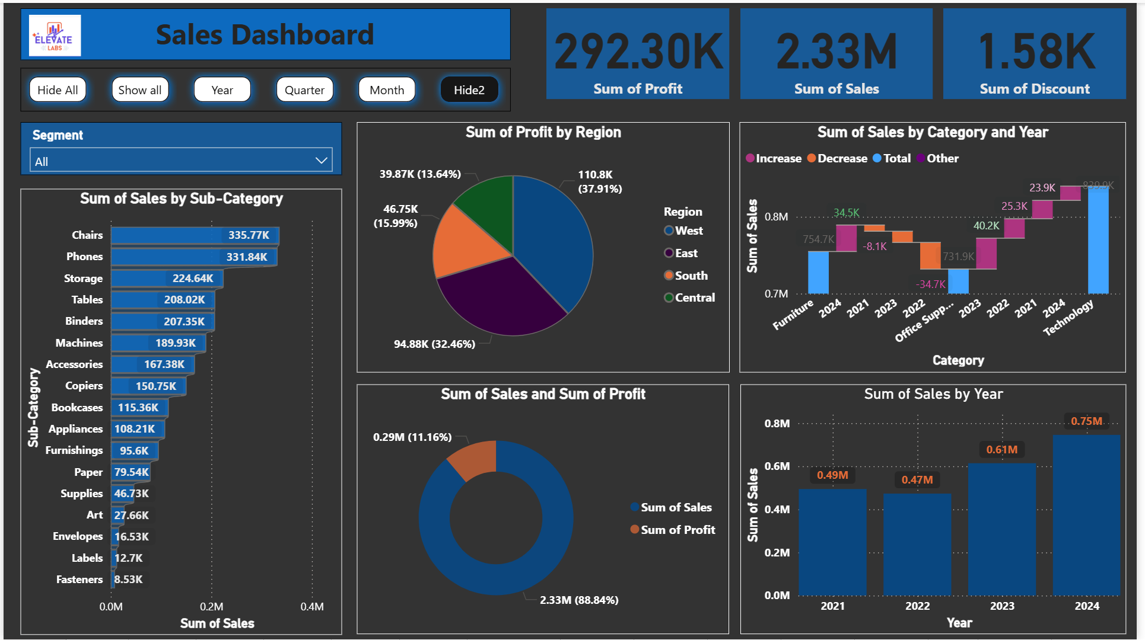

Slide 5
